Slide 1





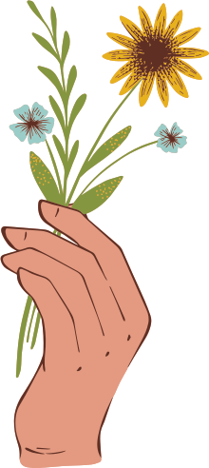

Digital
Portfolio

Slide 2
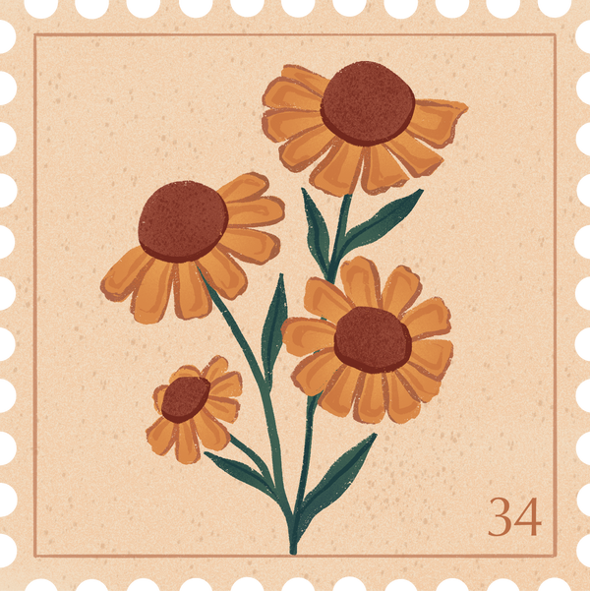

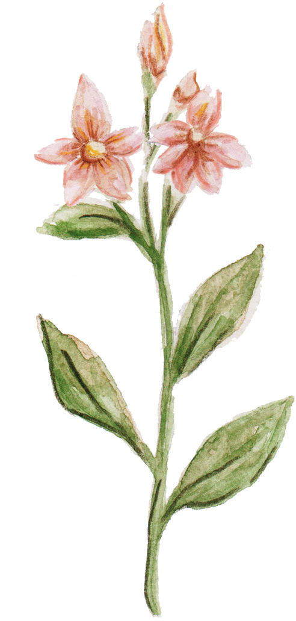
Project title:
STUDENT NAME : MALAIYARASI M
REGISTER NO AND NMID : 2A8BB30EA4D3B58A87643A3077345D7C
DEPARTMENT : B.SC COMPUTER SCIENCE
COLLEGE : VEL TECH RANGA SANKU ARTS COLLEGE / UNIVERSITY OF MADRAS

Slide 3
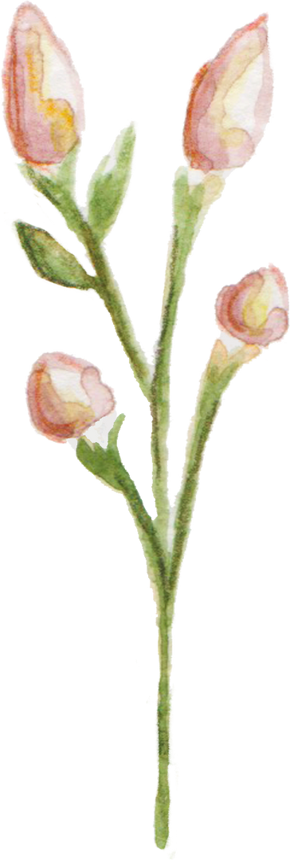

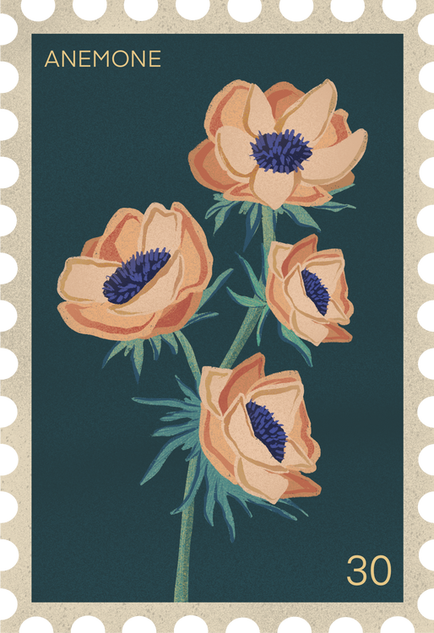

Agenda
1.Problem Statement 2.Project overview 3. End users 4.Tools and Technologies 5.Portfolio design and Layout 6. Features and Layout 7.Results and Screenshot 8. Conclusion 9.Github Link

Slide 4



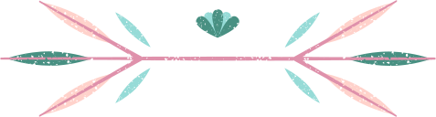
Problem Statement
In today's digital era, traditional resumes are not enough to effectively showcase skills and projects.
Many students and professionals lack a structured online presence to highlight their work and achievements.
A digital portfolio offers an interactive and accessible solution to present skills, experiences, and accomplishments in a modern, engaging way.

Slide 5


Problem Overview
Brief summary: This project is a digital portfolio to professionally present my background, skills, and creative work.
Contains key sections: About Me, Projects, Skills, and Contact for easy navigation.
Main idea: Showcase personal achievements, highlight technical expertise, and display completed projects in an organized manner.

Slide 6
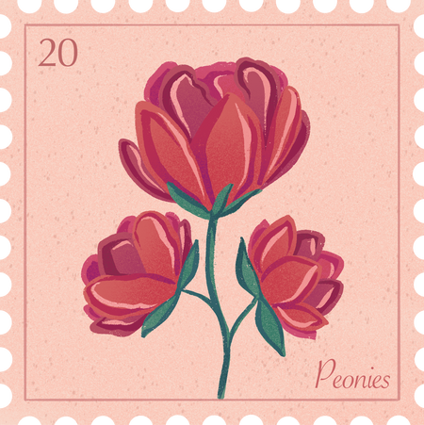




End Users
Students: Showcase academic projects, assignments, and build resumes for further studies.
Job Seekers: Share skills, experience, and portfolio with recruiters and employers.
Freelancers: Present work samples and completed projects to attract potential clients.
Professionals: Highlight career achievements, and ongoing development.

Slide 7




TOOLS AND TECHNIQUES
HTML: Builds the main structure of all portfolio pages and sections.
CSS: Styles the portfolio with colors, layouts, and makes it responsive for all device sizes.
JavaScript: Adds interactivity-navigation menu, animations, and form validation.
Code Editor: Developed using VS Code for efficient coding.
Hosting: Published online using GitHub Pages for easy sharing and access.

Slide 8
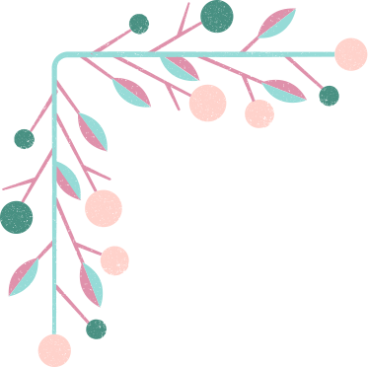

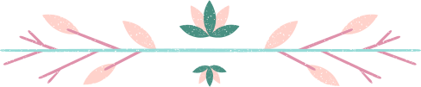
POTFOLIO DESIGN AND LAYOUT
Home/About Me, Projects, Skills, Contact.
Consistent color scheme and clean typography throughout the portfolio.
Easy navigation bar for smooth movement between sections.
Visual elements like icons and images for better engagement.
Fully responsive layout optimized for both mobile and desktop devices.

Slide 9




Features And Functionality
Navigation bar with smooth scrolling for easy access to all sections.
Project showcase including images and detailed descriptions for each project.
Interactive elements such as hover effects and animations to enhance user engagement.
Contact form with validation to ensure correct and complete user input.
Responsive design that works seamlessly on desktop, tablet, and mobile devices.

Slide 10
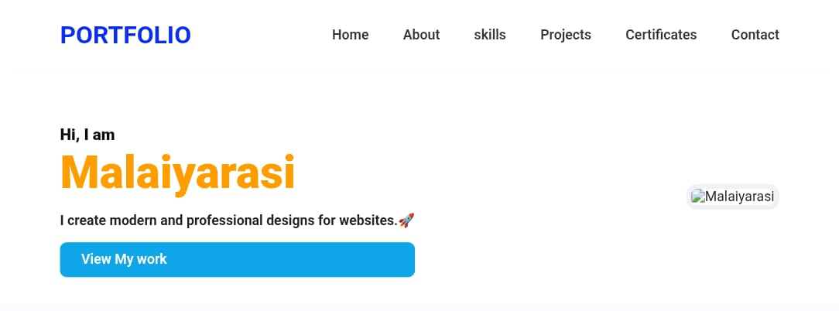
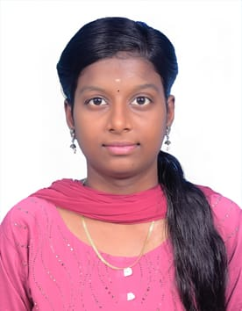
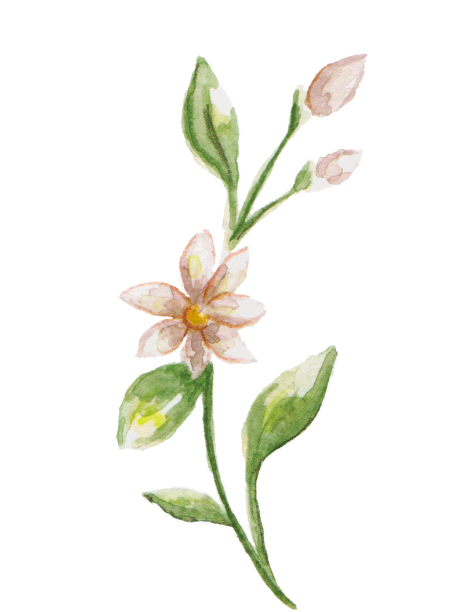
Results and Screenshot

Slide 11
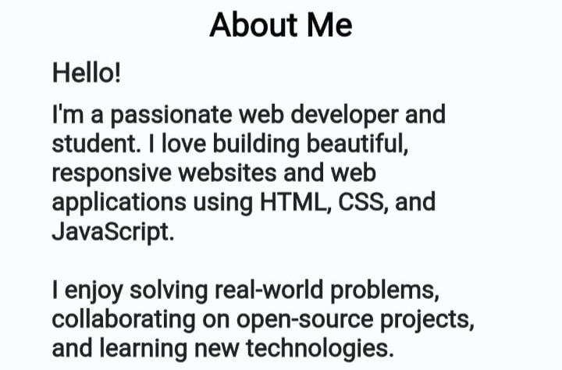



Slide 12
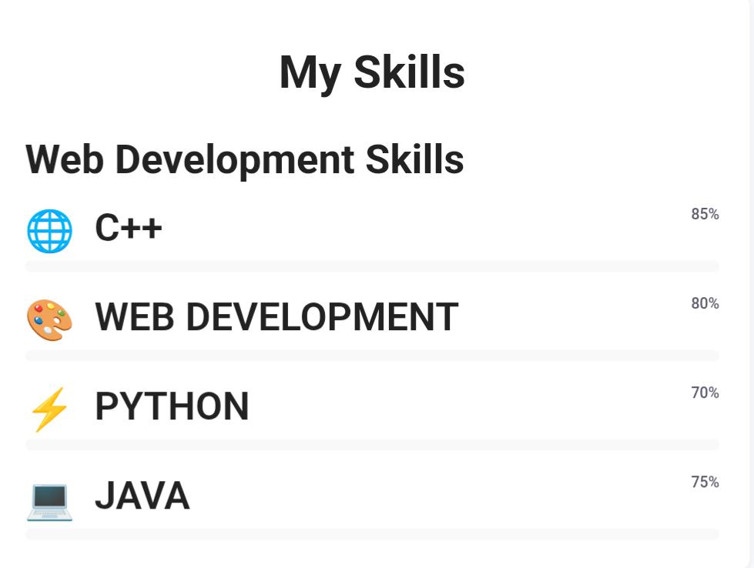

Slide 13
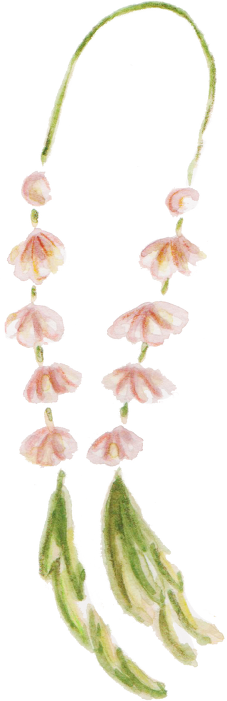

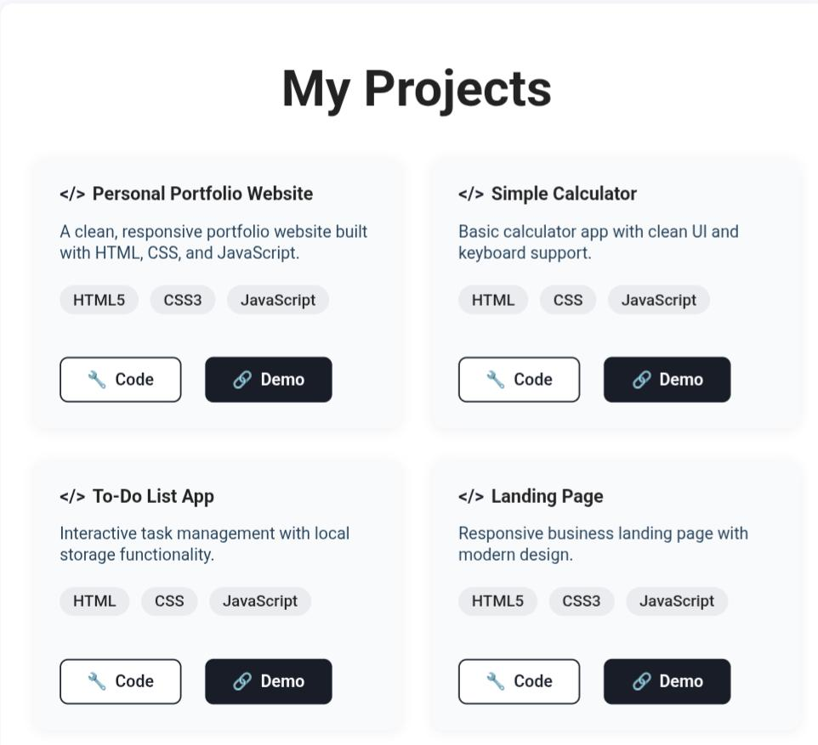

Slide 14




Slide 15
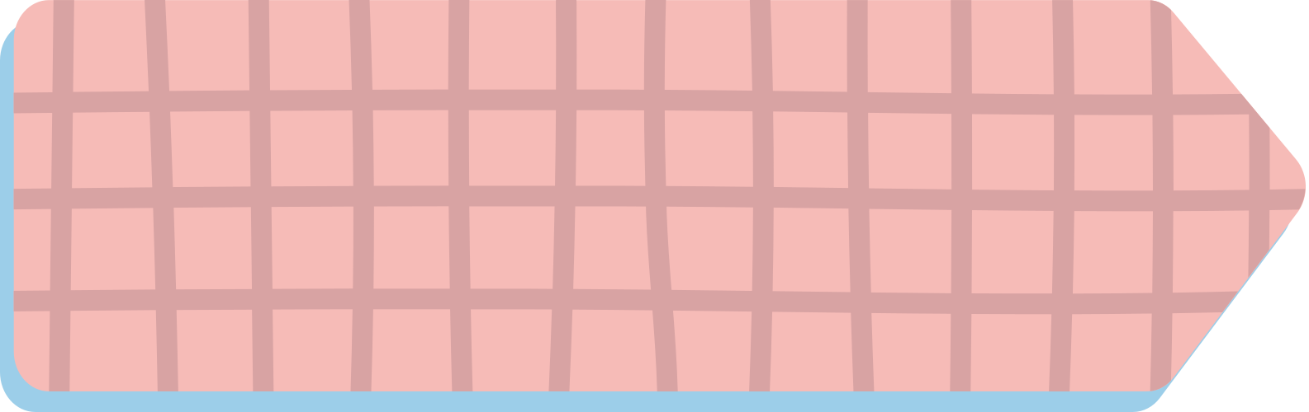
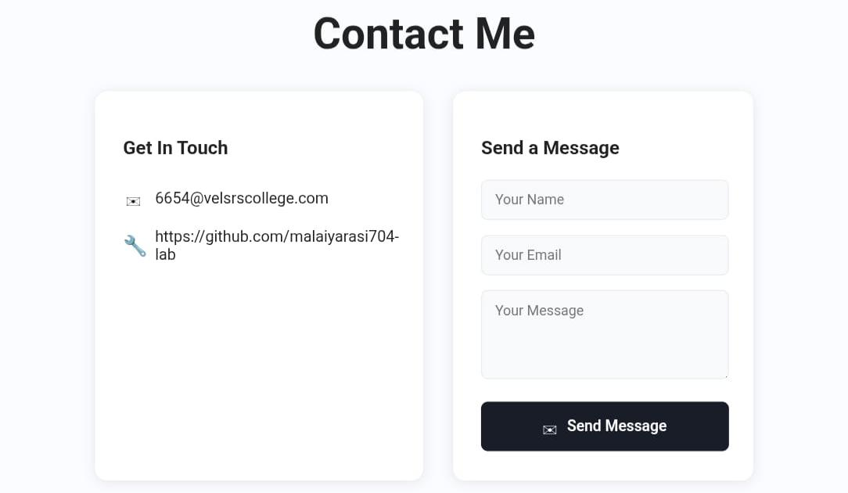
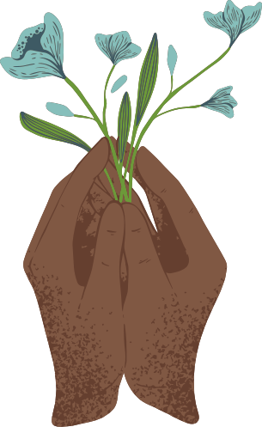

Slide 16




Conclusion
Achieved a modern, recruiter-friendly personal site with clear content architecture and accessible UI. Future upgrades: form backend/email API, projects page, SEO/meta tags, and cloud deployment. The utility-first workflow enabled rapid iteration and consistent theming without heavy tooling.ion, or supporting message

Slide 17

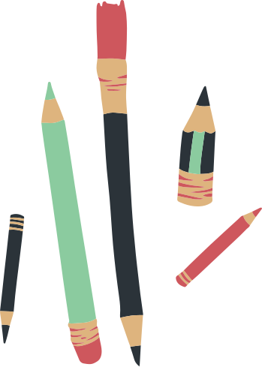
Github Link
PROJECT SOURCE CODE

Slide 18
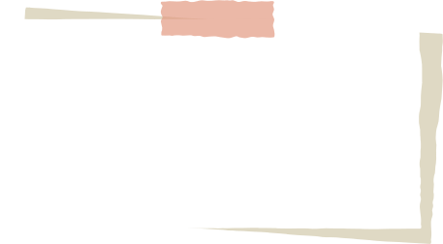

THANK YOU!

